Slide 1
VGP331 - Network Programming
Instructor: Peter Chan

Slide 2
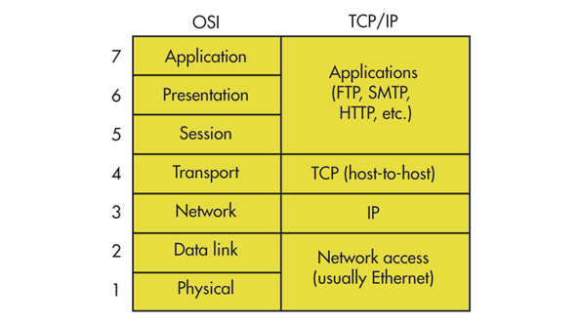
The TCP/IP Model

Slide 3
The Transport Layer
While the Network layer handles communication between distant hosts on remote networks, the Transport layer enables communication between individual processes on those hosts.
Since there may be multiple processes on a single host, just the IP address is not enough to ensure proper delivery of network packets.
To solve this, the Transport layer introduces the concept of ports.
A port is a 16-bit, unsigned number representing a communication endpoint at a particular host.

Slide 4
Ports
In theory, a process can bind to any port for communication. However, to avoid processes fighting over each other for ports, there is a port number registry maintained by the Internet Assigned Numbers Authority (https://www.iana.org/) that regulates port usage.
Ports 0 to 1023 are known as the system ports or reserved ports, these are usually used by the OS
Ports 1024 to 49151 are known as user ports that application developers can formally register.
Ports 49152 to 65535 are known as dynamic ports and are fair game for anyone to use

Slide 5
UDP
There are many different Transport layer protocols. The two most common ones are TCP and UDP.
User datagram protocol (UDP) is a lightweight protocol for wrapping data and sending it from a port on one host to a port on another host.
It consists of an 8-byte header followed by the payload data.
It is a connectionless, fire-and-forget protocol and makes no effort to guarantee data delivery. The main advantage is that it is much faster compared to TCP.

Slide 6
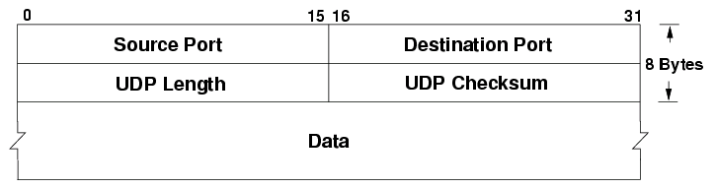
UDP Header

Slide 7
UDP Header
Source Port (16 bits) identifies the port from which the datagram originated, useful if the recipient wishes to respond
Destination Port (16 bits) is the target port
Length (16 bits) is the length of the UDP header and payload combined
Checksum (16 bits) is an optional checksum calculated based on the UDP header, payload, and certain fields of the IP header. If not calculated, this field is all zeroes.

Slide 8
TCP
Transmission Control Protocol (TCP) on the other hand, enables the creation of a persistent connection between two hosts followed by the reliable transfer of a stream of data.
TCP does its best to ensure all data sent is received, in its intended order, at its intended recipient. To achieve this, it requires a larger header (20 bytes) and more complex connection state tracking and transfer management.
TCP also handles error checking. Erroneous packets are retransmitted from the source to the destination.

Slide 9
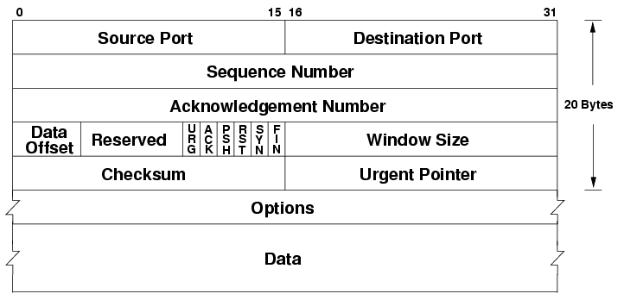
TCP Header

Slide 10
TCP Header
Sequence Number (32 bits) is a monotonically increasing identifier. Each byte transferred via TCP has a consecutive sequence number which uniquely identifies that byte. The sequence number of a TCP segment is typically the same number as the first byte of data in that segment.
Acknowledgment number (32 bits) is the sequence number of the next byte of data the sender is expecting. Since TCP guarantees all data is delivered in order, this means the sender is acknowledging receipt of all bytes lower than this value.

Slide 11
TCP Header
Data Offset (4 bits) specifies the length of the header in 32-bit words. TCP allows for optional header elements so the size can be between 20 to 64 bytes between the start of the header and the data of the segment.
Control Bits (9 bits) hold metadata about the header.
Receive Window (16 bits) conveys the maximum amount of remaining buffer space the sender has for incoming data. This is useful for maintaining flow control.

Slide 12
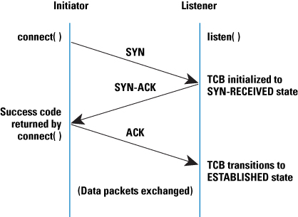
TCP Handshake

Slide 13
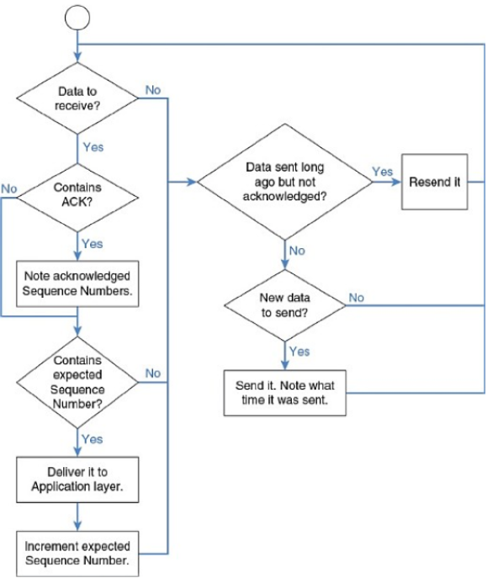
TCP Data Transfer

Slide 14
TCP vs UDP
TCP | UDP
Connection-oriented protocol | Connectionless protocol
Suited for applications that require high reliability, transmission time is relatively less critical | Suited for applications that need fast, efficient transmission, packet loss and ordering are less critical
HTTP, HTTPs, FTP, SMTP | DNS, DHCP, VOIP
Rearranges data packet in order | No inherent order of packets
Data transfer is guaranteed | Message/packets can be lost
Performs error checking, bad packets will be retransmitted | Performs error checking, bad packets are simply discarded
Acknowledgement on segment transfer | No acknowledgement

Slide 15
Berkeley Sockets API
Originally released as part of BSD 4.2 (1983), the Berkeley Sockets API provides a standardized way for processes to interface with various levels of the TCP/IP stack.
The API has been ported to every major operating system (and most popular programming languages
Reference: https://en.wikipedia.org/wiki/Berkeley_sockets
(Berkeley Software Distribution (BSD) is a Unix operating system derivative developed and distributed by the Computer Systems Research Group (CSRG) of the University of California, Berkeley, from 1977 to 1995.)

Slide 16
UDP Socket
To create a UDP socket using IPv4 protocol:
SOCKET udpSocket = socket(AF_INET, SOCK_DGRAM, IPPROTO_UDP or 0);
To send and receive data using UDP sockets:
int sendto(SOCKET sock, const char* buf, int len, int flags,
const sockaddr* to, int tolen);
int recvfrom(SOCKET sock, char* buf, int len, int flags,
sockaddr* from, int* fromlen);

Slide 17
UDP Socket Class
class UDPSocket
{
public:
int Bind(const SocketAddress& toAddress);
int SendTo(const void* buffer, int len, const SocketAddress& toAddress);
int ReceiveFrom(void* buffer, int len, SocketAddress& fromAddress);
private:
SOCKET mSocket;
};

Slide 18
TCP Socket
To create a TCP socket using IPv4 protocol:
SOCKET tcpSocket = socket(AF_INET, SOCK_STREAM, IPPROTO_TCP or 0);
To send and receive data using TCP sockets:
int send(SOCKET sock, const char* buf, int len, int flags);
int recv(SOCKET sock, char* buf, int len, int flags);

Slide 19
TCP Socket Class
class TCPSocket
{
public:
int Connect(const SocketAddress& toAddress);
int Bind(const SocketAddress& toAddress);
int Listen(int backLog);
TCPSocket* Accept(SocketAddress& fromAddress);
int Send(const void* buffer, int len);
int Receive(void* buffer, int len);
private:
SOCKET mSocket;
};

Slide 20
SocketAddress Class
class SocketAddress
{
public:
SocketAddress(uint32_t address, uint16_t port);
SocketAddress(const char* address, uint16_t port);
private:
sockaddr_in mSockAddr;
};

